Slide 1


Business Intelligence Consulting Planning | Design | Power BI Development
Sam Hopkins
BI Practice Lead
shopkins@affirma.com
Sarah Scherer
Sr. Director of Sales
425.281.5716
sscherer@affirma.com

Slide 2
Our Understanding
Our Understanding
We understand that Boundless Network is looking for a partner to help them realize their vision of becoming a data driven organization. Everyone at Boundless is extremely excited about this initiative from the executive team down to the individual contributors. The current state of reporting is that data sits in many disparate systems across the company, making analytics highly manual and time consuming.
Affirma plans to propose the right solution and technology tools to bring this initiative to life. We view this opportunity as a multi phase initiative that will scale over time and continually empower Boundless’ leadership to make informed decisions that drive growth in the business. For Phase I (included in this proposal), we will focus on consolidating the must have data sources (Salesforce, Google Analytics, Portal Reporting and Mixpanel), account based analytics (online vs. offline) and streamlining existing reports that take hours to create. We have also included Great Plains as an optional nice to have data source.
Project Success Criteria
Management is able to report on up to date financial and operational data across the business from Salesforce, Google Analytics, Portal Reporting and Mixpanel (optionally Great Plains as well)
Affirma suggests the optimal technology stack to implement the solution
Account level analytics is in place and empowering stakeholders to make better decisions and take actions more confidently
Reports that currently take hours to create are streamlined to free up employee’s time
Data is refreshed at least daily
The time to create and view financial and operational data is drastically decreased. When reports are viewed, stakeholders can trust that the data is current
Solution is architected to easily add additional source systems in future phases

Slide 3



Engagement Overview: Project Phases
Planning
Business Requirements Gathering
BI Tools Assessment & Recommendations
Architecture and Roadmap
Implementation
Data Modeling & Tool Setup
Agile Sprints for Source Systems (ETL, Dashboards, QA, Review)
Development & Production Servers
SQL Server
Networking
Deployment
Additional QA & Bug Fixing
User Acceptance Testing
Documentation & Training
Development & Production Servers
SQL Server
Networking
Notes:
Structure begins with initial program/project planning
Effectively gathering business requirements is fundamental to a successful BI project
Technology Track: the technologies utilized in the solution
Data Track: how the data is to be stored, and the means by which it will be extracted, transformed, and prepared to be analyzed by a BI Application
BI Application Track: the choice of BI Apps that are best aligned with the various business needs

Slide 4
Project Organization Chart
Support Team
Boundless Primary Point of Contact
General Manager
Project Manager
Solution Architect
Engagement Manager

Slide 5
Our Approach

Slide 6
Our Process: BI Approach
DISCOVERY
IMPLEMENTATION
DEPLOY
SUPPORT
Technical Design
Project Planning
Business
Requirements
Technology Track
Infrastructure Integration | Product Configuration
Training, Test & Deployment
Growth
Data Track
Data Modeling, ETL Design
Support & Maintenance
Visualization Track Reporting Tool
Project Management
Notes:
Structure begins with initial program/project planning
Effectively gathering business requirements is fundamental to a successful BI project
Technology Track: the technologies utilized in the solution
Data Track: how the data is to be stored, and the means by which it will be extracted, transformed, and prepared to be analyzed by a BI Application
BI Application Track: the choice of BI Apps that are best aligned with the various business needs

Slide 7
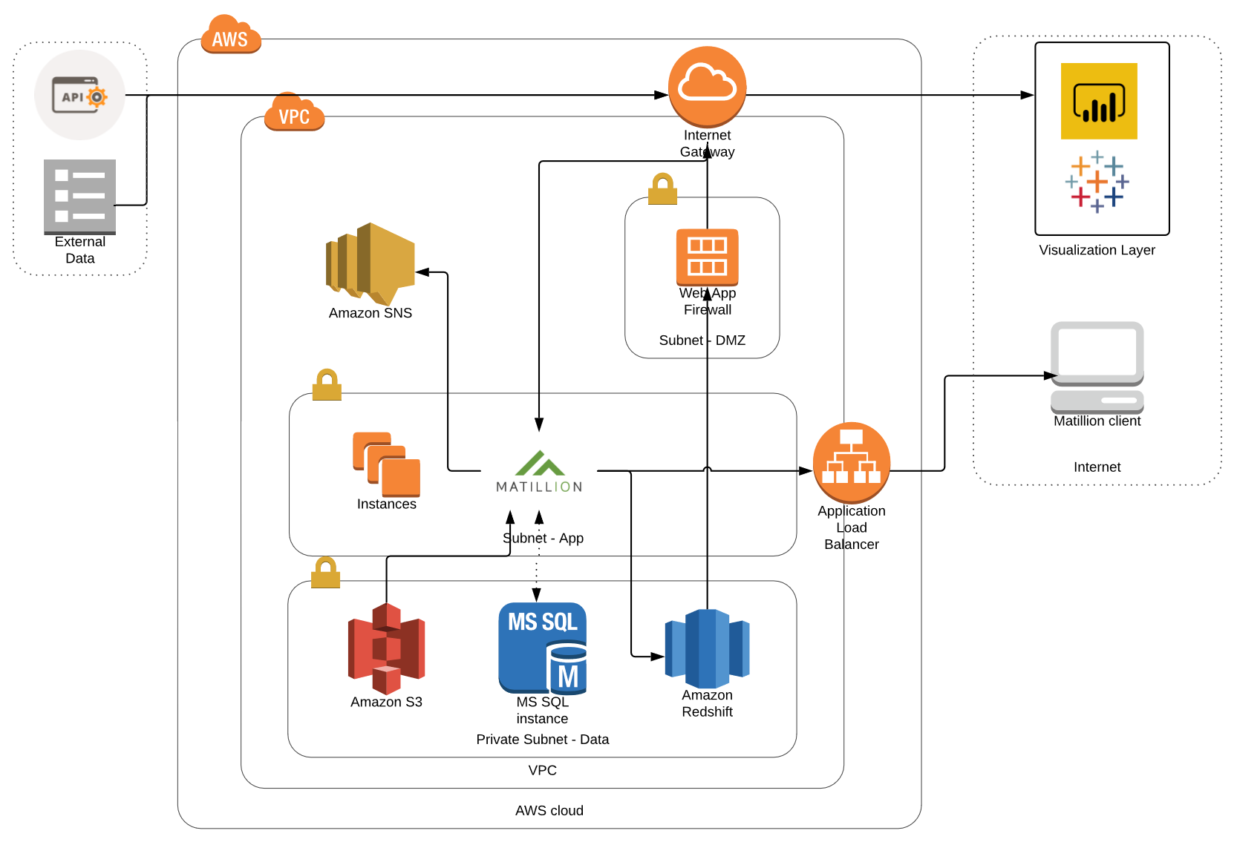
Potential Technical Approach 1
Notes:
Structure begins with initial program/project planning
Effectively gathering business requirements is fundamental to a successful BI project
Technology Track: the technologies utilized in the solution
Data Track: how the data is to be stored, and the means by which it will be extracted, transformed, and prepared to be analyzed by a BI Application
BI Application Track: the choice of BI Apps that are best aligned with the various business needs

Slide 8
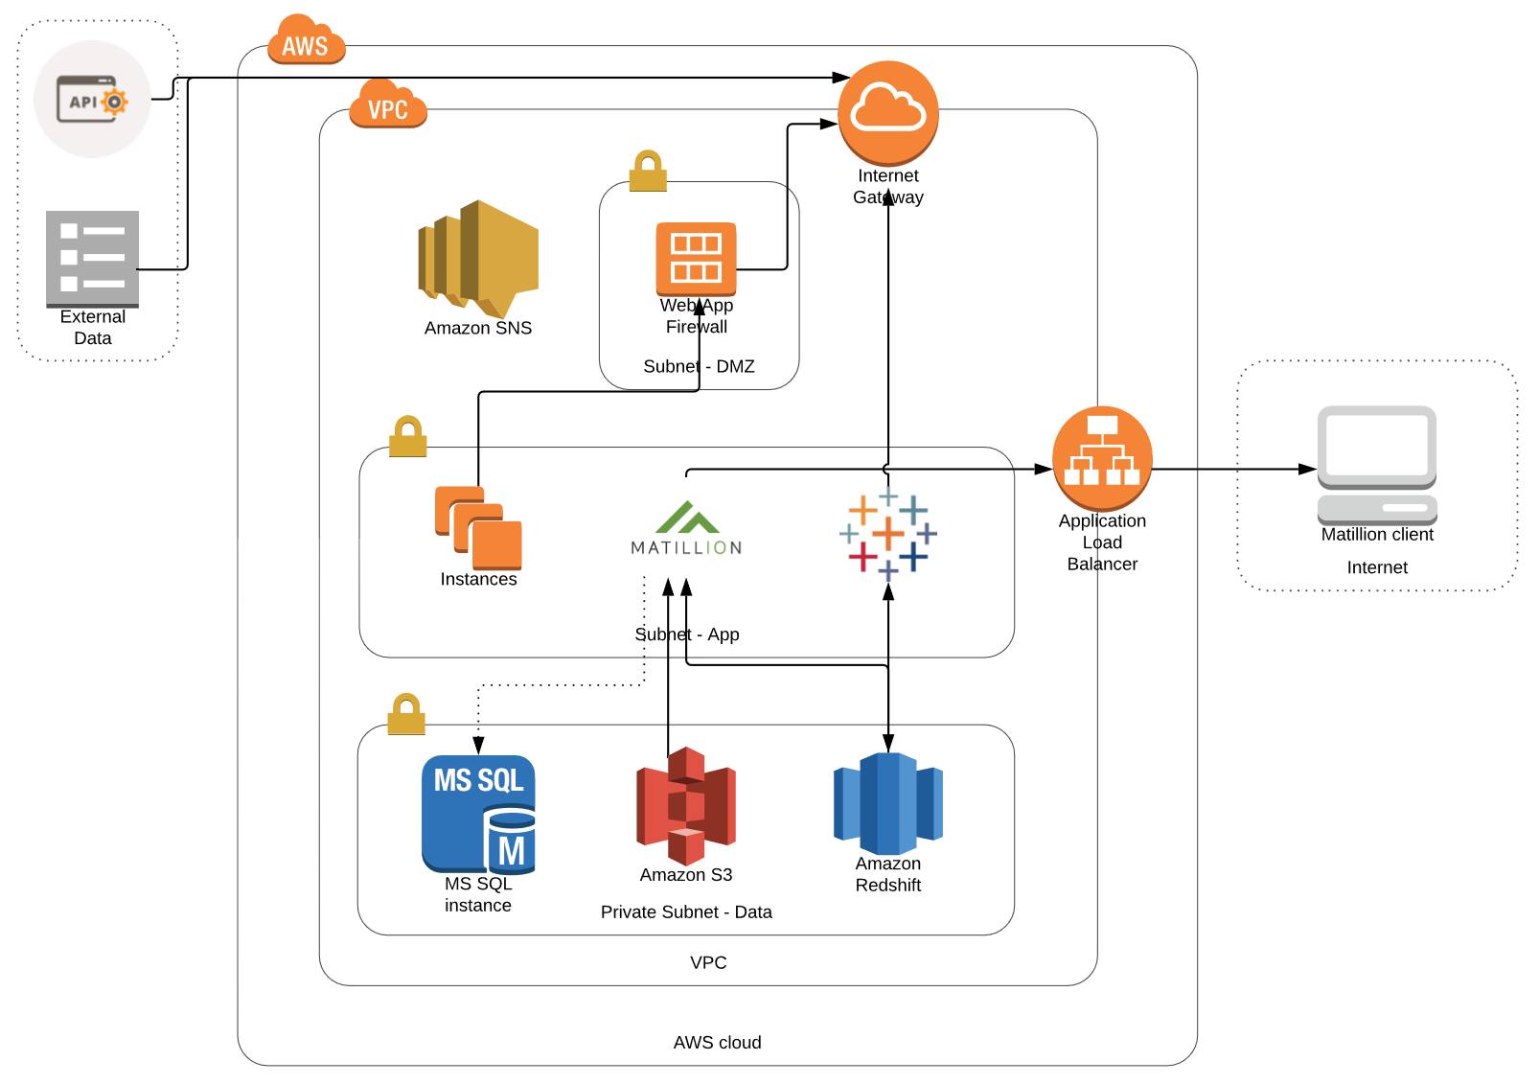
Potential Technical Approach 2
Notes:
Structure begins with initial program/project planning
Effectively gathering business requirements is fundamental to a successful BI project
Technology Track: the technologies utilized in the solution
Data Track: how the data is to be stored, and the means by which it will be extracted, transformed, and prepared to be analyzed by a BI Application
BI Application Track: the choice of BI Apps that are best aligned with the various business needs

Slide 9
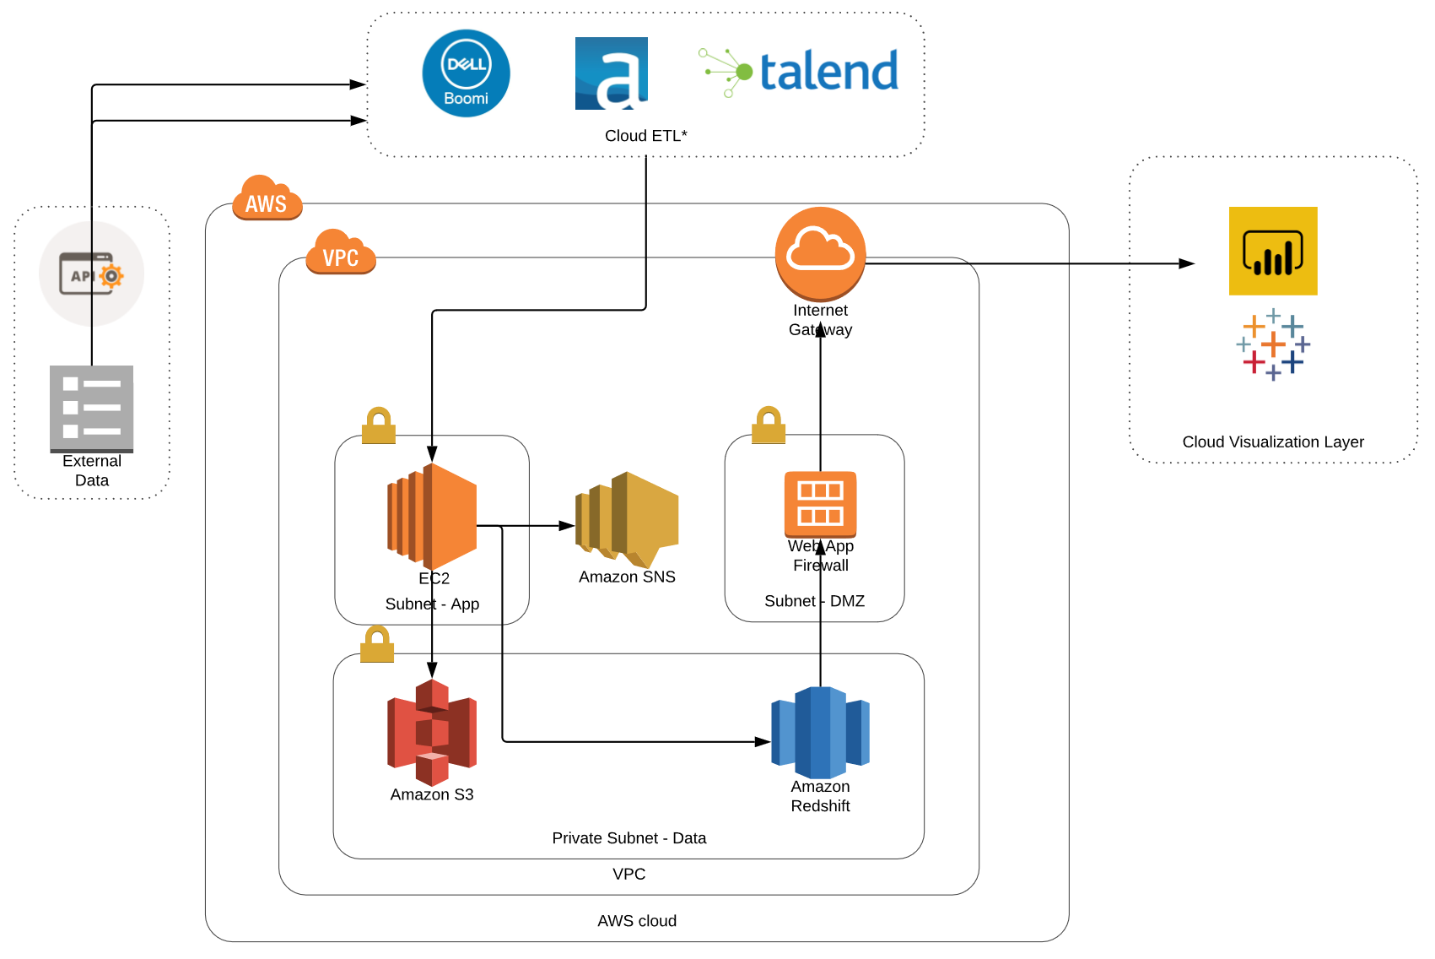
Potential Technical Approach 3
Notes:
Structure begins with initial program/project planning
Effectively gathering business requirements is fundamental to a successful BI project
Technology Track: the technologies utilized in the solution
Data Track: how the data is to be stored, and the means by which it will be extracted, transformed, and prepared to be analyzed by a BI Application
BI Application Track: the choice of BI Apps that are best aligned with the various business needs

Slide 10
Project Financials & Timeline

Slide 11
Project Estimate
Time & Materials Estimate
Affirma is proposing that this engagement will be worked towards under a time and materials agreement. Affirma’s Project Manager will maintain strong communication with the Boundless Network Project Team on scope, investment, project milestones and deliverables throughout the engagement. The actual cost of the project could vary from this estimate based on collaborative decisions made between the Boundless Network and Affirma team. Data source simplicity or complexity is a driver for the estimated cost range. This estimate does not include travel expenses.
Hourly Rates
Estimate Summary
Role | Standard Rate | Discounted Rate
Project Manager | $200/hour | $180/hour
BI Solution Architect | $195/hour | $180/hour
Project Category Estimated Cost
Planning | $14k - $16k
Implementation | $60k - $66k
Deployment | $34k - $38k
Estimated Total Cost | $108k - $120k
Great Plains Integration (Optional) | $14k - $16k

Slide 12
Project Estimate
Project Category Estimated Cost
Discovery, Planning & Design Role |  | Rate | Est. Hours | Est. Cost
Project Management | Project Manager | $180 | 20 | $3,600
Discovery Sessions & Stakeholder Interviews | BI Solution Architect | $180 | 16 | $2,880
BI Technology Stack Assessment & Recommendations | BI Solution Architect | $180 | 20 | $4,320
BI Architecture Diagram | BI Solution Architect | $180 | 12 | $2,880
BI Roadmap | BI Solution Architect | $180 | 8 | $1,440
Client Review Sessions | BI Solution Architect | $180 | 8 | $2,880

Slide 13
Project Estimate
Project Category Estimated Cost
Implementation Role |  | Rate | Est. Hours | Est. Cost
Project Management | Project Manager | $180 | 48 | $8,640
Data Discovery & Modeling (Overall) | BI Solution Architect | $180 | 20 | $3,600
Setup Redshift & S3 in existing AWS account | BI Solution Architect | $180 | 8 | $1,440
Setup ETL Tool* | BI Solution Architect | $180 | 16 | $2,880
ETL API for Salesforce | BI Solution Architect | $180 | 40 | $7,200
ETL API for Mixpanel | BI Solution Architect | $180 | 40 | $7,200
ETL API for Google Analytics | BI Solution Architect | $180 | 24 | $4,320
ETL API for Portal Reporting | BI Solution Architect | $180 | 60 | $10,800
Data Governance Framework | BI Solution Architect | $180 | 16 | $2,880
Create reporting view(s) 1-3 | BI Solution Architect | $180 | 16 | $2,880
Vizualzation Tool Setup* | BI Solution Architect | $180 | 24 | $4,320
Dashboard Development (1 Dashboard) | BI Solution Architect | $180 | 24 | $4,320
Dashboard Best Practices and Template Setup | BI Solution Architect | $180 | 16 | $2,880

Slide 14
Project Estimate
Project Category Estimated Cost
Deployment & Training Role |  | Rate | Est. Hours | Est. Cost
Project Management | Project Manager | $180 | 32 | $5,760
Quality Assurance/Testing | BI Solution Architect | $180 | 32 | $5,760
Bug Fixing | BI Solution Architect | $180 | 24 | $4,320
Client UAT Support | BI Solution Architect | $180 | 8 | $1,440
ETL Iterations w/ UAT Feedback | BI Solution Architect | $180 | 32 | $5,760
Visualization Iterations w/ UAT Feedback | BI Solution Architect | $180 | 16 | $2,880
Documentation w/BI Process Recommendations | BI Solution Architect | $180 | 24 | $4,320
Training & Knowledge Transfer | BI Solution Architect | $180 | 32 | $5,760
(Optional) Great Plains Integration Role |  | Rate | Est. Hours | Est. Cost
Great Plains - Data Discovery | BI Solution Architect | $180 | 8 | $1,440
Great Plains - ETL API | BI Solution Architect | $180 | 60 | $10,800
Great Plains - QA & Bug Fixing | BI Solution Architect | $180 | 16 | $2,880

Slide 15
Project Schedule
Month 1 | Month 2 | Month 3 | Month 4
Discovery & Business Requirements
BI Tools Assessment
BI Architecture
BI Roadmap
Data Modeling, Tools Setup
Salesforce: ETL, Dashboard
QA, Client Review
Mixpanel: ETL, Dashboard
QA, Client Review
Google Analytics: ETL, Dashboard
QA, Client Review
Portal Reporting: ETL, Dashboard
QA, Client Review
Additional QA & UAT
GP: ETL, Dashboard
QA, Client Review
Training & KT
*Sprints can be staggered based on client preference and resource availability.
*GP is optional
Documentation
Planning
Implementation
Deployment
Launch Support

Slide 16
Project Assumptions
Project Specific Assumptions
Client must purchase an ETL and Visualization Tool.
Client has proper VPC and subnet setup in AWS.
Affirma will need to have full admin access to most tools in order to setup ETL, AWS, Visualization, and source systems.
Great Plains is considered a nice to have optional scope item.
General Assumptions
All work shall be scheduled and performed during normal business hours as reasonably possible, Monday - Friday, 8am – 5pm PST except Holidays.
Affirma shall not take responsibility for any errors, incompatibilities or defects in third party software or network devices. Any errors, incompatibilities, or defects in such software or devices may add time and cost to the project.
Unless specifically noted, Affirma does not guarantee compliance with Sarbanes-Oxley, HIPAA, or any other regulatory or industry documentation requirements.
Affirma is not responsible for delays, errors, or omissions caused or incurred by the Client or its representatives or vendors. Such delays, errors, or omissions may increase the time and cost of the project.

Slide 17
ETL & Visualization Tool Costs & Comparison

Slide 18
ETL Tool Costs
Feature | Matillion | Talend | Boomi | Alteryx
Easy to Use | Y | Y | Y | Y
IT Tool | Y | Y | Y | M
Business Application | M | M | M | Y
Meta-Driven Approach | Y | Y | Y | N
Clustering & Distribution | Y | Y | Y | Y
Multiple Join | Y | Y | Y | Y
Graphical Data Mapper | Y | Y | Y | N
Complex Transormations | Y | Y | Y | Y
Data Validations | Y | Y | Y | Y
Preview Source Data in Design | Y | Y | Y | Y
Version Control | Y | Y | Y | N
Real Time | 60 seconds | Y** | Y** | 60 Seconds
Alerts | Y | Y | Y | Y
Environments | Y | Y | Y | Model Based
Unlimited Connectors | Y | Y | N | Y
Connectors | 100+ | 900+ | 1500+ | 100+
Data Storage | In memory | 1 Hr Talend Server | Y - Atom | N - Mango DB Temp or DBA
Value Add
 | Uses AWS |  | Highest Connectivity | Machine Learning
Pricing
Model | Hourly | User Based | Connector Based | User*
Esimated per year | 1.37 Per Hour or $10K per year | 12K | 18-25K | 10K
Users | Tier Based | Named | Unlimited | Named
*Model is based on a user with one scheduler
**Cost
Notes
N/A | Limited to Redshift, Big Query & Snowflake | N/A | N/A | N/A
 | Amazon SQS Integration
Costs are for the tools alone and do not take in account server or instance to run them.
Estimated AWS Costs will range from 0.1 – 0.266 per hour.

Slide 19
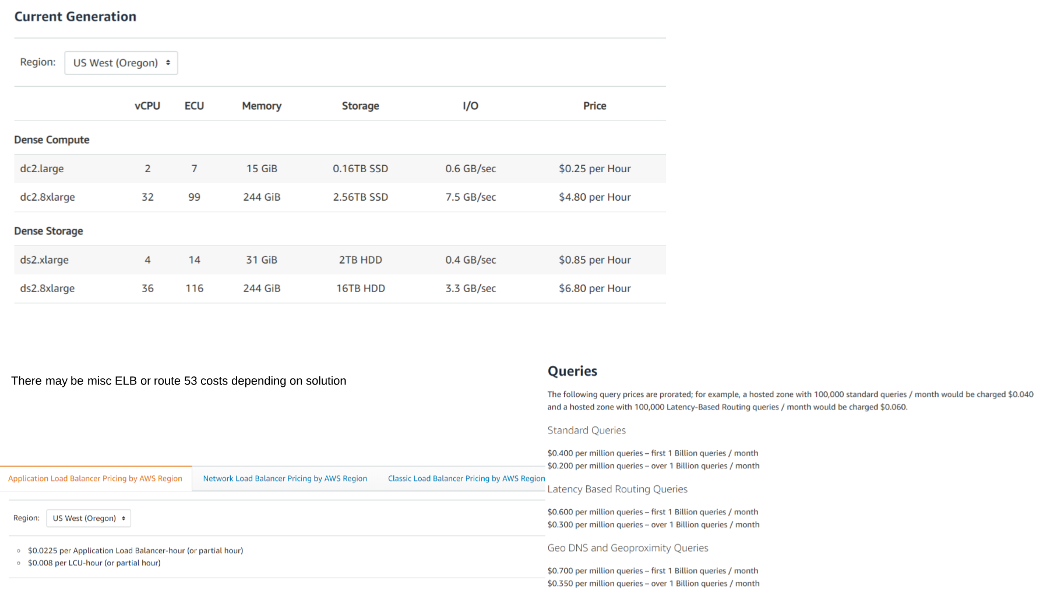
Redshift Costs

Slide 20
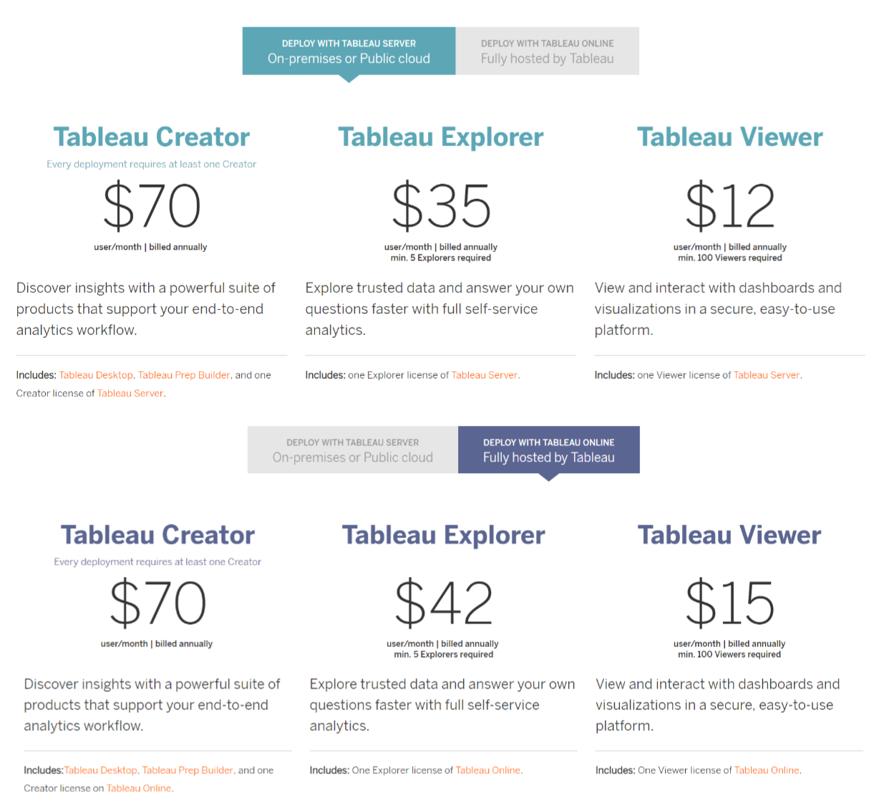
Tableau Costs

Slide 21
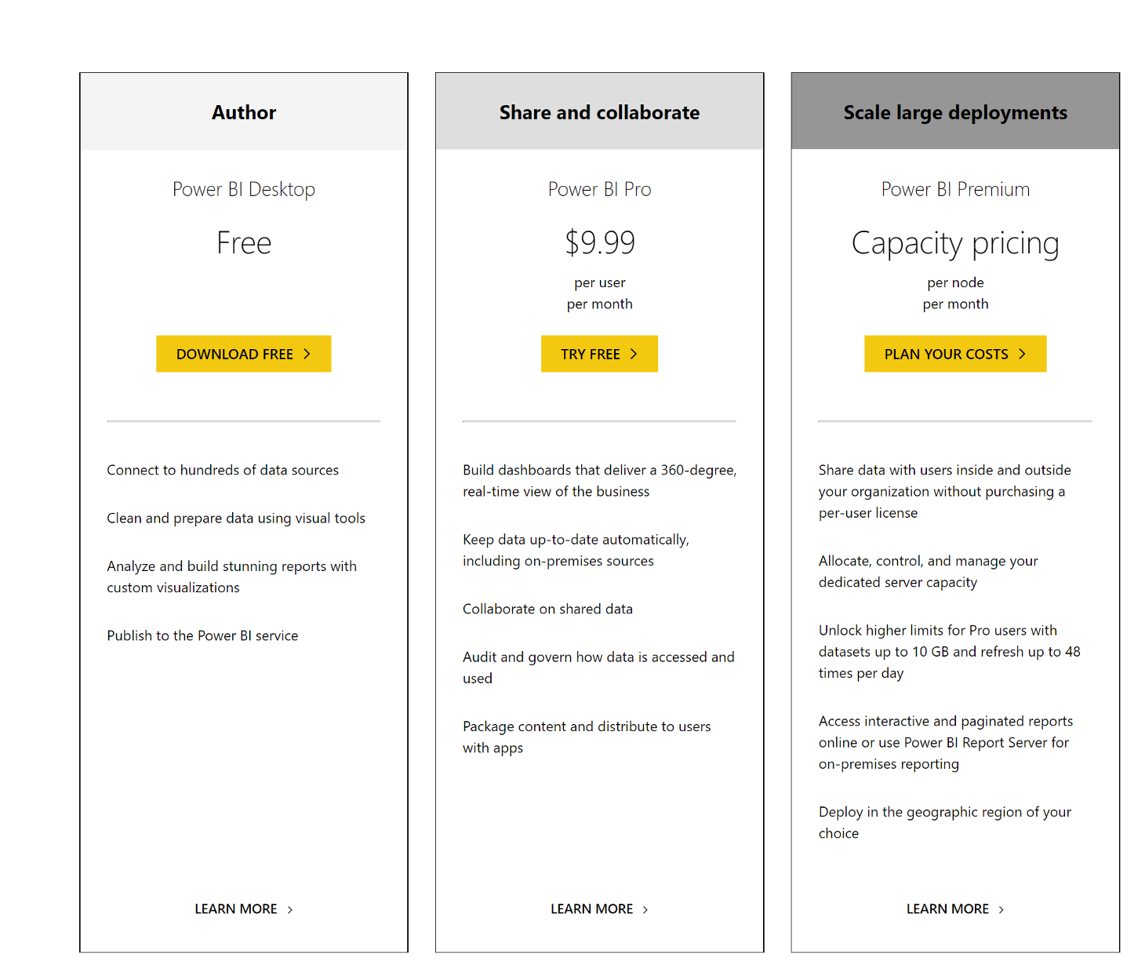
Power BI Costs

Slide 22
About Affirma

Slide 23




Company Overview
OUR MISSION
“Become the best at applying solutions and services to positively impact people.”
300+
Employees globally
98%
Dublin, Ireland
Customer Satisfaction
Bellevue, WA
Reno, NV
16
Ahmedabad, India
Los Angeles, CA
Years in business

Slide 24






Why Affirma?
Customer satisfaction
Breadth & Depth of Experience
Relevant experience
Our CEO, executives, project managers, developers, testers, & account managers
200+ Software Services team members providing Business Intelligence Consulting, Application Development & Integration
all have Customer Satisfaction as the #1 metric on their scorecard.
ETL Design & Development, Report Development & Data Warehousing, Web & Mobile Application Development,

Slide 25









Clients

Slide 26
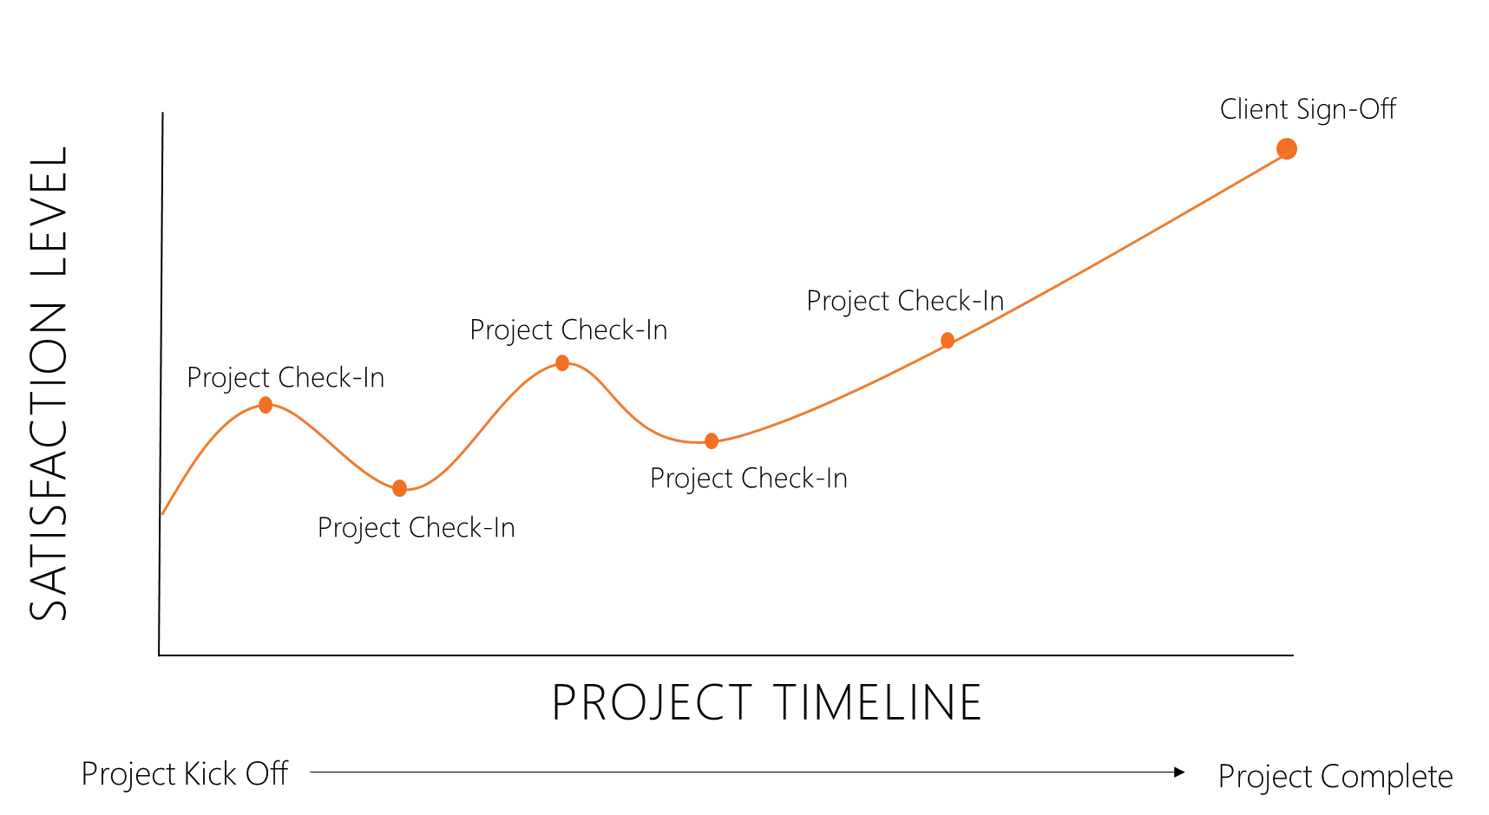
Customer Satisfaction
Customer Experience
Measure of client experience throughout the course of an engagement. This is a data driven metric, gathered every 2-3 weeks by Affirma Account Manager. Any client concerns, even minor points of feedback that arise are flagged and resolved immediately by the responsible General Manager and Practice Lead.
Customer Satisfaction
Measure of client satisfaction at the end of an engagement. This is a data driven metric, gathered by a 3rd party service after the completion of each project.

Slide 27
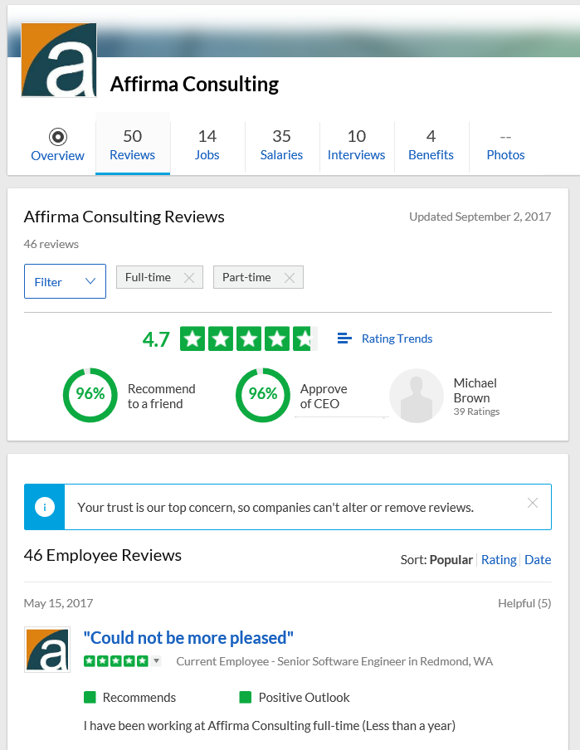


Employee Satisfaction
Employee Satisfaction
Since Affirma started 16 years ago, Employee Satisfaction and Customer Satisfaction have been our top organizational values. Affirma’s leadership team is very diligent in facilitating employee feedback loops through multiple channels to ensure employees are heard and adjustments can be made.
Affirma Awards
Affirma is a 5-time Inc 5000 winner recognizing Americas fastest growing companies. We have recently been ranked #43 in Washington’s top 100 fastest growing private companies. Affirma has been highlighted by the Puget Sound Business Journal four years in a row for being a “Top 100 Fastest Growing Private Company on the Eastside” as well as a “Washington’s Best Places to work.” We have been named Microsoft’s Partner of the Year and Microsoft’s General Manager Award. These awards are a testament to Affirma’s ability to provide impactful solutions to our clients and reflect the company’s exponential growth in both revenue and number of employees.
Check out Affirma on Glassdoor
We strongly encourage you to review Affirma’s Glassdoor ratings, as well as the those of the other vendors involved in this process. You will find that Affirma has industry leading scores in regards to employee feedback, something we are very proud of.

Slide 28
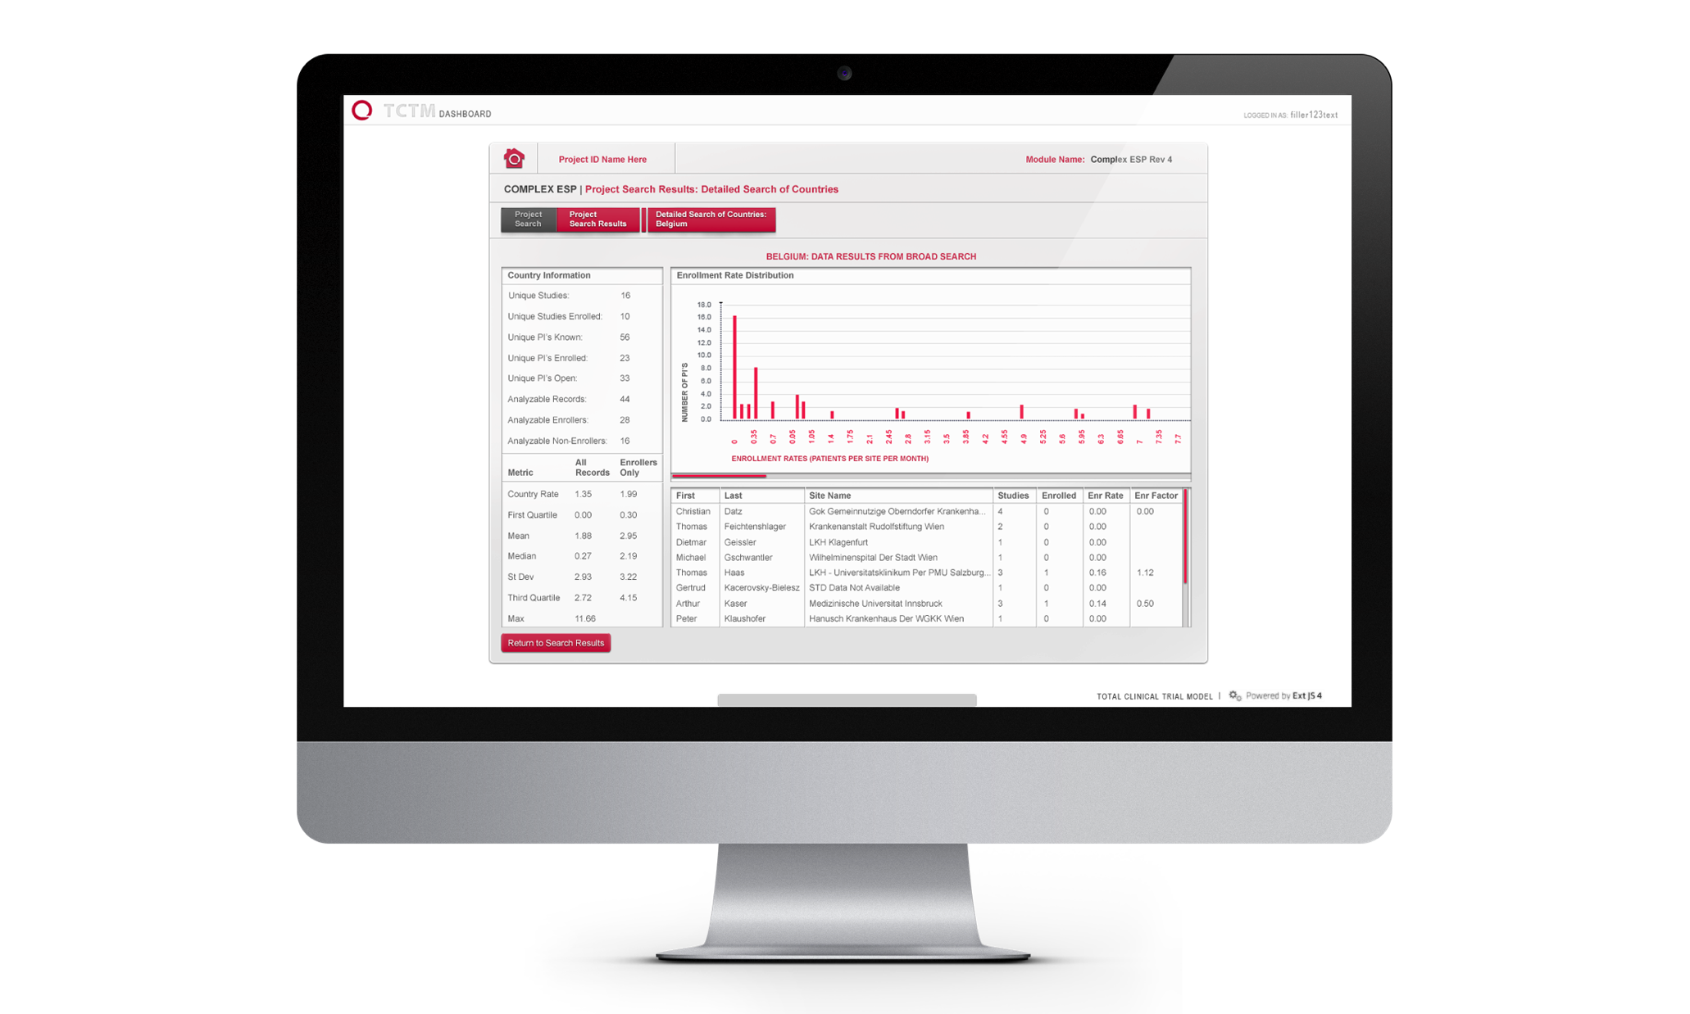









Business Intelligence Consulting
Our consulting and engineering teams can guide your organization down the path to a healthy BI solution. We ensure that the solution becomes a single source of truth for your organization, allowing you to answer tough questions and enhance alignment across departments.
Program Management & Strategy Development
Technical Approach Planning
Data Warehouse, Data Mart & Cube Design
Extensive Data Validation & Cleanup
Reporting, Dashboard & Scorecard Development

Slide 29
Our Business Intelligence Services
Data Warehouse and Database Consulting
We have expertise in designing, building, and maintaining database architecture ranging from data warehouses to transactional databases. We have strong experience working with most mainstream database platforms including Microsoft SQL Server, Oracle, Microsoft Azure, Amazon, and more. If you need a database assessment, performance tuning, or expertise with data warehouses, we can help. Without strong database architecture, usability and efficiency of any solution can suffer greatly.
Analytics Consulting
We can help develop key business reports, dashboards and analytics using industry standard tools such as Microsoft Power BI, SQL Server Reporting Services, Qlik View, and Tableau. If you are looking for superior in-depth analysis of your data, we can help with the development of an OLAP Cube or Tabular Model. These analytical tools bring self-service Business Intelligence to your organization and allow for fast analysis and predictive analytics.
Strategic Business Intelligence Consulting
We understand that not every organization is ready to implement a Business Intelligence system or replace their current Business Intelligence environment. We can partner with you to understand your current reporting and analytical needs and recommend a strategic approach for introducing a Business Intelligence system. This Strategic Business Intelligence Consulting facilitates a thorough understanding of your current environment and the investment needed to implement a scalable, enterprise solution.

Slide 30




Our Business Intelligence Services
Database Platforms Microsoft SQL Server 2000 – 2016 Microsoft Azure ORACLE MySQL Amazon RDS Amazon Redshift Elastic Search Hadoop ETL SQL Server Integration Services Azure Data Factory Informatica ETL Works | Reporting and Analytics Microsoft SQL Server Analysis Services Multi-dimensional Tabular Microsoft SQL Server Reporting Services Power BI PowerPivot Tableau QlikView Qlik Sense Business Objects Partnerships

Slide 31

Our Approach – BI Maturity

Slide 32
Relevant Work

Slide 33
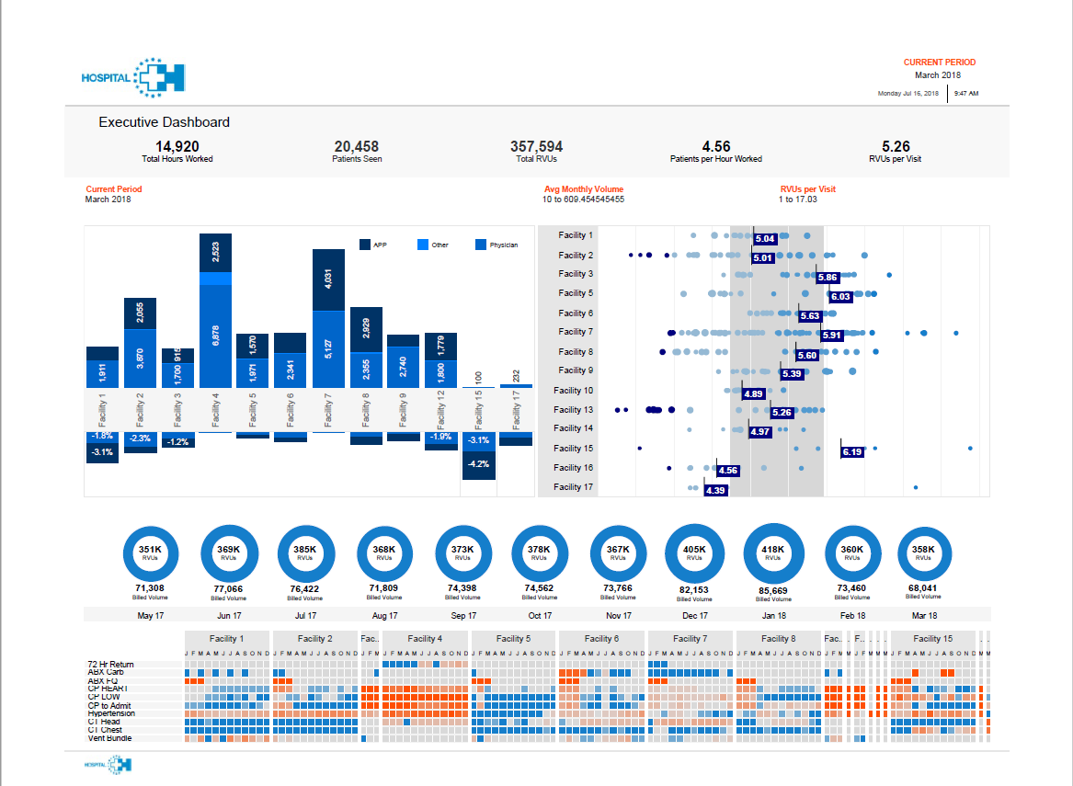
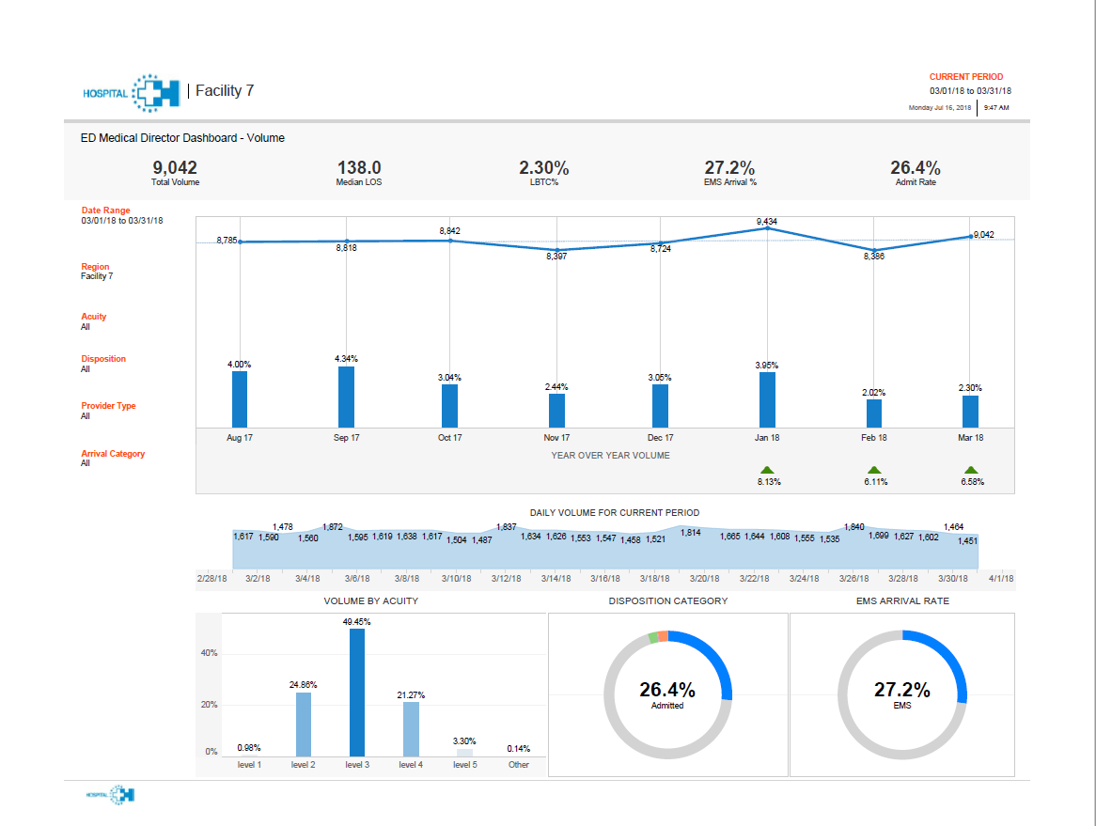
Dashboard Development – Healthcare Client

Slide 34
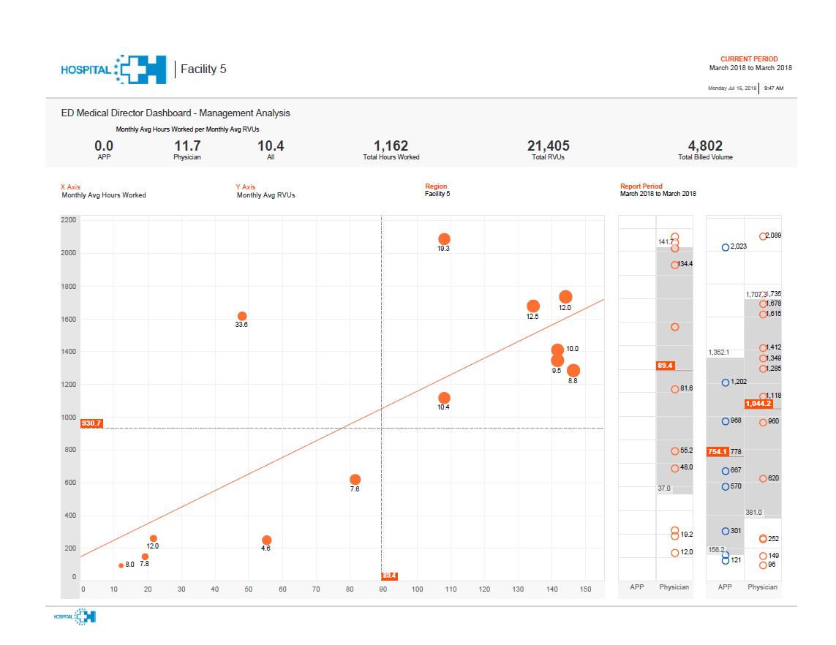
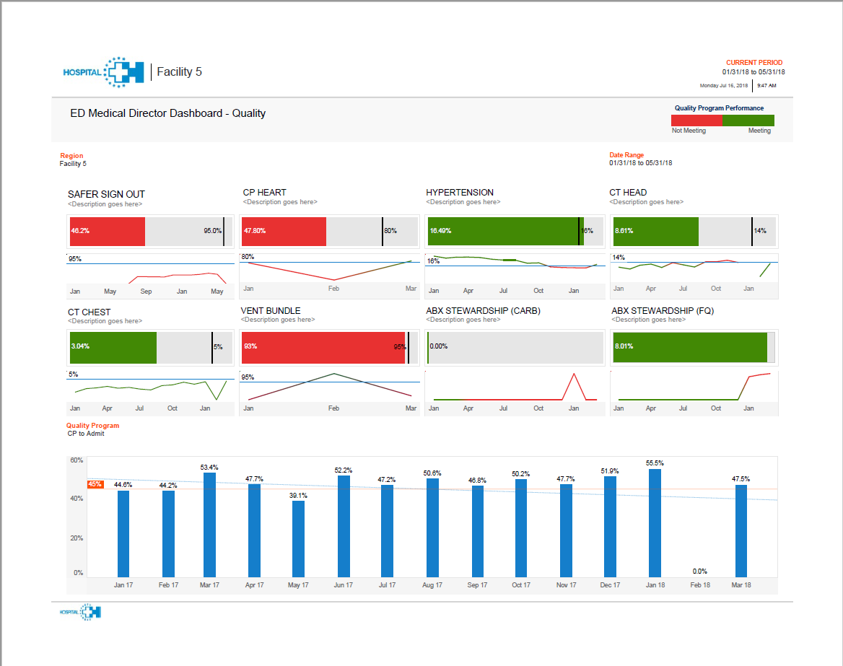
Example Tableau Dashboards

Slide 35
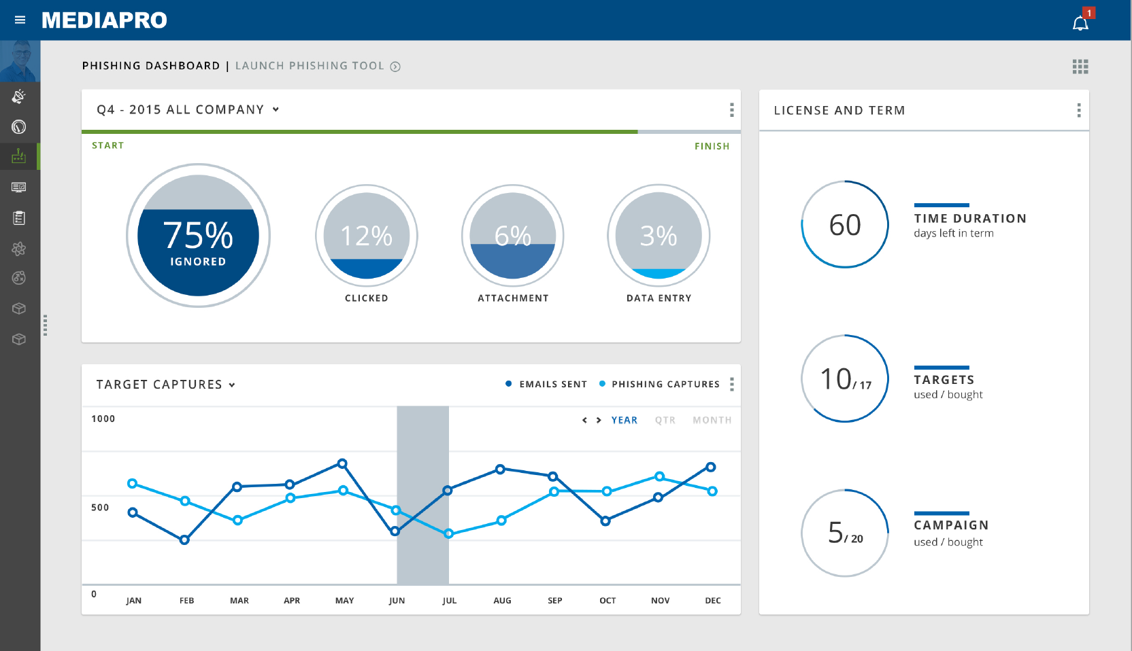
MediaPro Dashboard Design

Slide 36
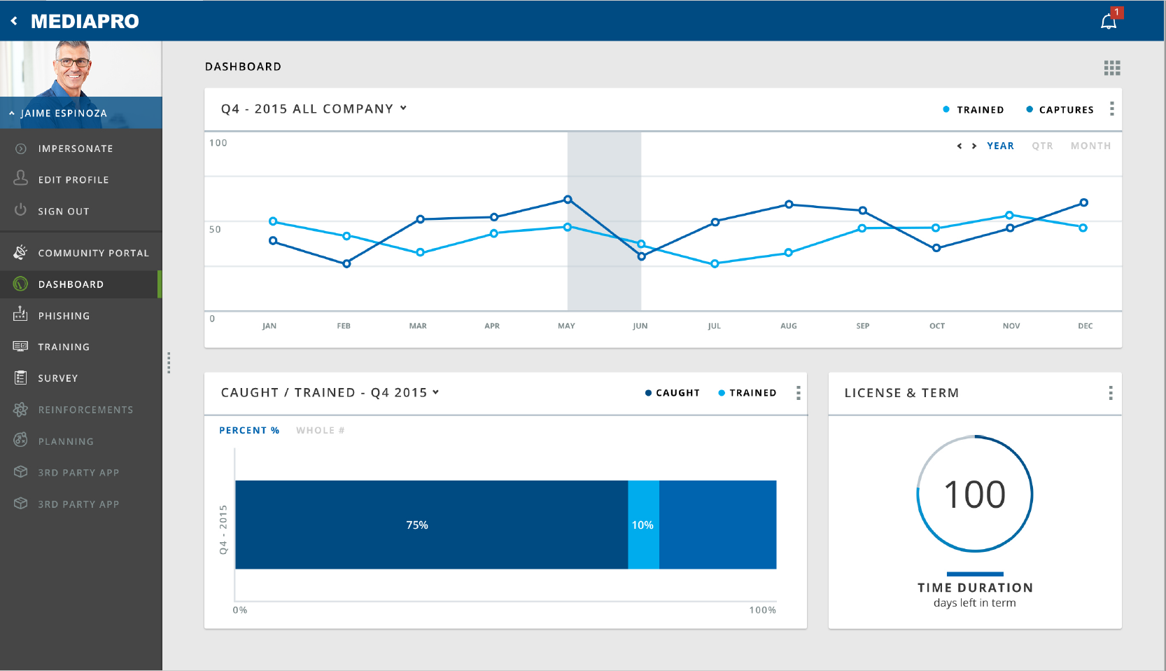
MediaPro Dashboard Design

Slide 37
Quintiles Business Intelligence
Business Need
Quintiles Dashboard Quintiles, a large scale CRO, approached Affirma with a set of unique challenges. Multiple business units had approached their IT innovations department with concerns that their current tools were unable to keep up with their large-scale data processing demands. Quintiles asked the Affirma team to discern critical areas for improvement and to implement the changes needed. Affirma identified several core challenges: integrating data contained in disparate locations, enhancing data processing speed and scalability, as well as improving the poor user-interface design.
What We Did
Affirma designed a data warehouse and dashboarding solution that addressed Quintiles’ primary pain points.
The solution involves the construction of an umbrella API dashboard to house a multitude of tools.
Without leaving the simple, intuitive dashboard interface, users can: access different data sources, display powerful visuals, identify the necessary attributes with an array of upgraded tools, and generate results to support high-impact business units.

Slide 38
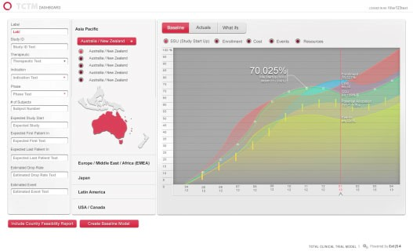
Quintiles Business Intelligence

Slide 39
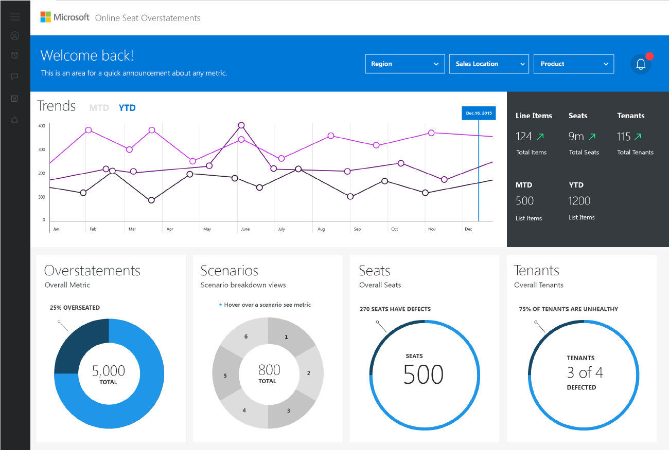
Microsoft Dashboard Design

Slide 40
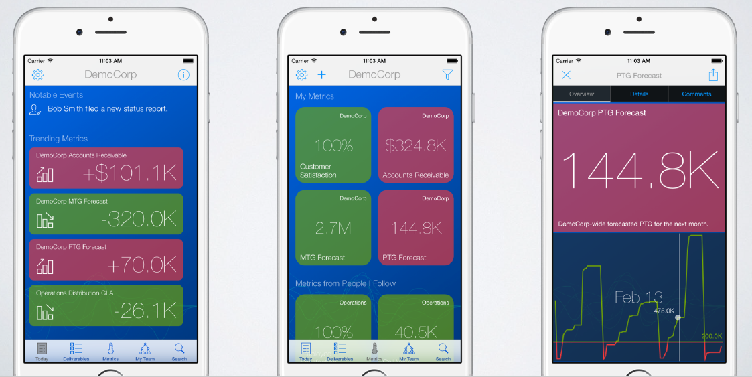
Sightline – Mobile Business Intelligence

Slide 41
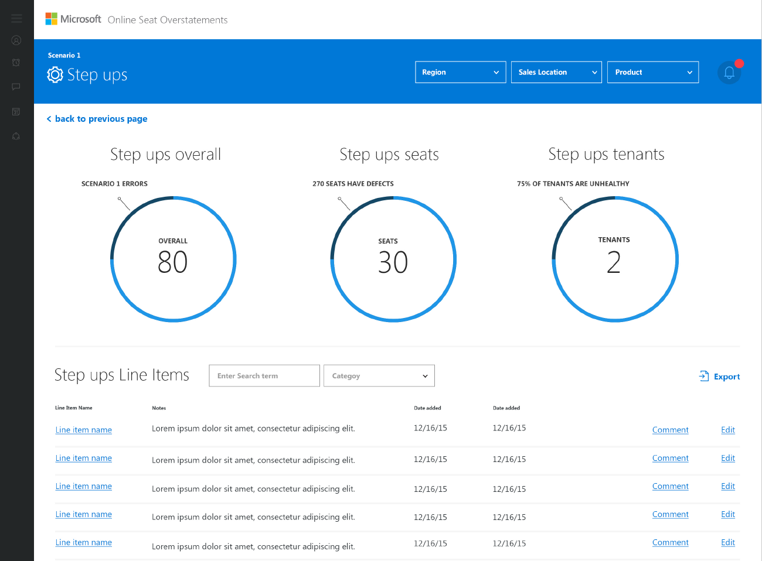
Microsoft Dashboard Design

Slide 42

Moneytree BI Strategy & Implementation
Business Need
Moneytree wanted a comprehensive review of their current Business Intelligence systems to ensure they were being fully utilized. Additionally, there were internal business needs to create new self-service capabilities.
What We Did
Affirma partnered with Moneytree Executives and conducted a two-month Design Phase analysis of Moneytree Business Intelligence systems, reporting processes, data warehouse methodologies, and business needs. At the end of the Design Phase, strategic recommendations were presented that would transform reporting practices and streamline data analysis.
We developed an enterprise SQL Server Analysis Services OLAP cube that allows simple drag-and-drop of financial and business aspects.
Without leaving the common interfaces of Excel or Tableau, users can: access the entire transaction history of a specific customer and quickly generate reports that used to take weeks

Slide 43

Twin Rivers USD BI Implementation
Business Need
Twin Rivers Unified School District approached Affirma to create a partnership for designing, implementing and supporting a district-wide data warehouse; and providing guidance in selecting the right Business Intelligence tool to analyze results from the data warehouse.
What We Did
Affirma partnered with Twin Rivers Unified School District to design and develop a district-wide data warehouse that encompasses key metrics related to attendance and assessments.
We carefully evaluated industry Business Intelligence tools to find the best tool for the faculty and administration in terms of ease of use and capabilities; and the tool with the lowest total cost of ownership (TCO). The final application decided upon was Tableau.
Using SQL Server 2016, SQL Server Integration Services, and Tableau, timely analysis of student and teacher metrics can be performed and quicker decisions around a student’s education can be addressed.

Slide 44
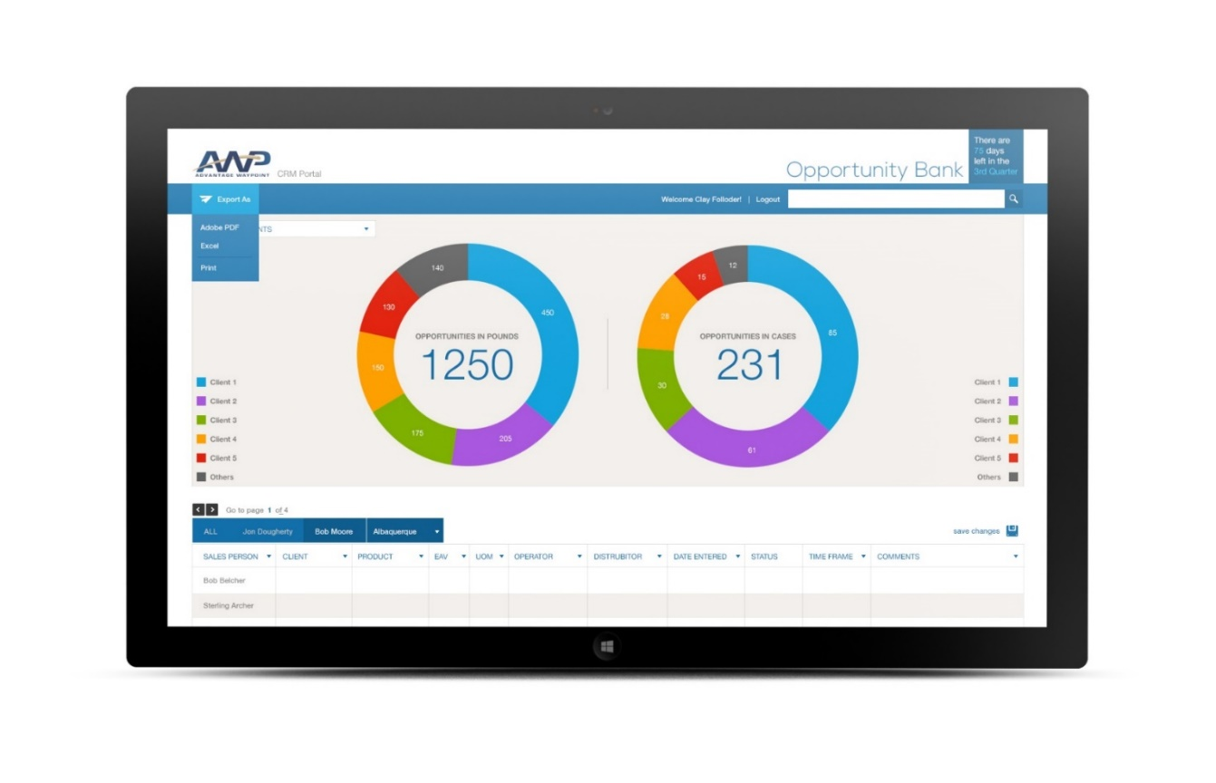
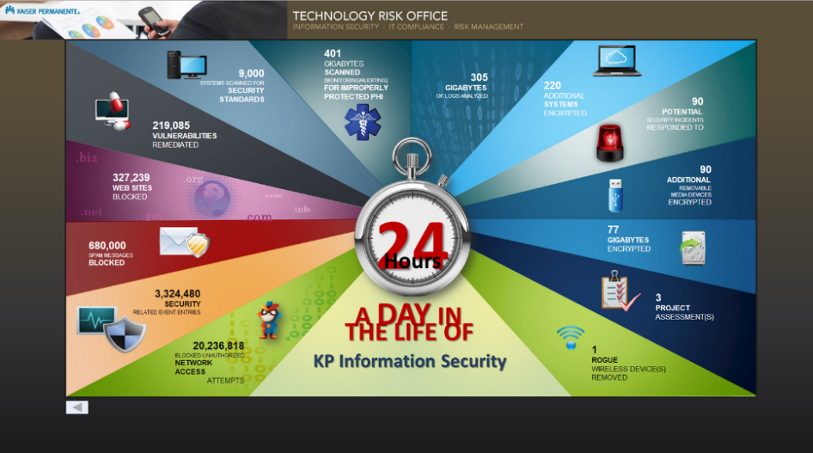

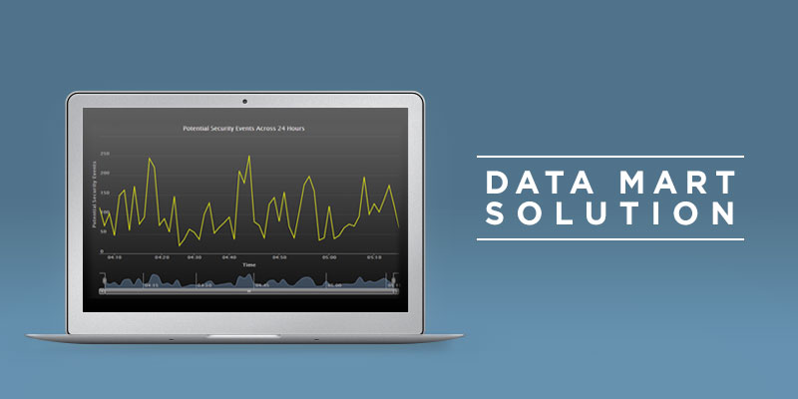
Kaiser Permanente: Data Mart
Business Need
Kaiser Permanente, one of the nation's largest managed health care firms, needed to implement data security measures under the Health and Information Trust Alliance (HITRUST). HITRUST is a certification framework that is used by organizations to securely create, access, store and exchange personal health and financial information. Affirma was contracted to convert Kaiser’s prototype data security platform into a fully-functional Data mart solution that could monitor all of the organization’s highly sensitive data.
What We Did
Affirma converted a prototype of the data-feed to a complete and fully functional .NET/SQL solution
Created a lightning-fast digital read-out that allows users to identify any spikes in security issues quickly and easily.
Built a dynamic user interface so that users of the Data mart solution have up-to-date information to use when monitoring and tracking their systems.
Kaiser Permanente was very pleased with the Data mart solution. Kaiser now has the ability to easily identify and monitor any security issues in their system, ranging from unauthorized network access attempts to improperly protected health information and blocked spam messages.

Slide 45
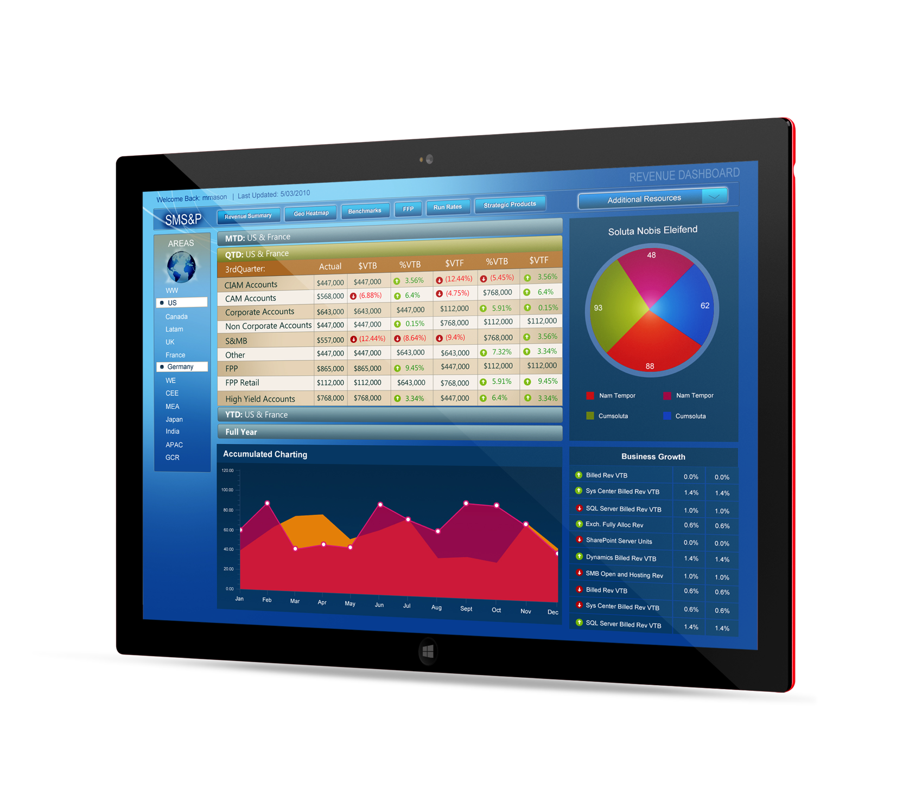
Microsoft SMS&P Dashboard
Business Need
Microsoft Small and Midmarket Solutions & Partners needed a way to create financial accountability while allowing all levels of the organization to make more insightful decisions with real-time and accurate information.
What We Did
Created an interactive dashboard that configured all data access from multiple data sources
Geographic KPI interactivity allows Finance Executives to view key performance indicators quickly
Executives can drill data by metric, time and geography, even when offline

Slide 46
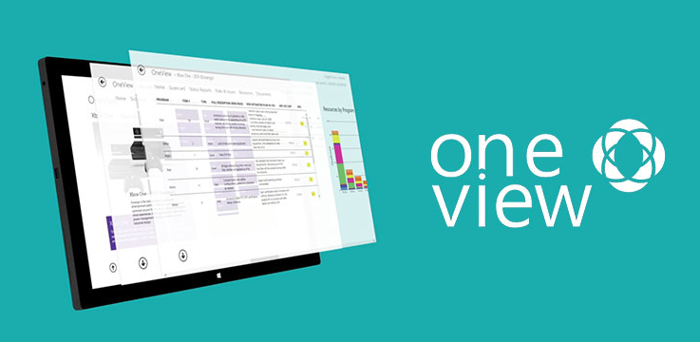
Microsoft OneView Application
Business Need
Microsoft came to Affirma with a request to build a BI platform to view and manage status on hundreds of projects across their entire Interactive Entertainment Business (IEB) Group. The application needed comprehensive Scorecards and dashboards for executives and operations teams. While an existing site was in production already, it was in need of an upgrade. The request was to create a product that was easy-to-use, attractive, and appealing to users. Additionally, the new custom-built app would work off of their original project management database. The app needed to support information for 10,000 people in the department, displaying all of their projects and activities. The app was initially meant for Microsoft executives to manage progress, status reports, and resource information of projects, but grew to full-use after the success of the first roll-out.
What We Did
Analyzed the existing database which included researching and modifying unidentified edge-cases and business rules.
Designed a new application from the ground up, using Windows RT framework and XAML for the UI.
Implemented a charting tool to meaningfully display thousands of resources on a PC or tablet.
Deployed the app into Microsoft’s internal store and received certification, allowing it to be used as an example for future applications.
Results
The app was released into the internal Microsoft store and was a huge success among the employees. After testing it, Microsoft asked us to build a Windows Phone version, which is currently undergoing development. The app is easy-to-use, and helps the PMs at Microsoft manage projects and resources more efficiently, increasing productivity.

Slide 47

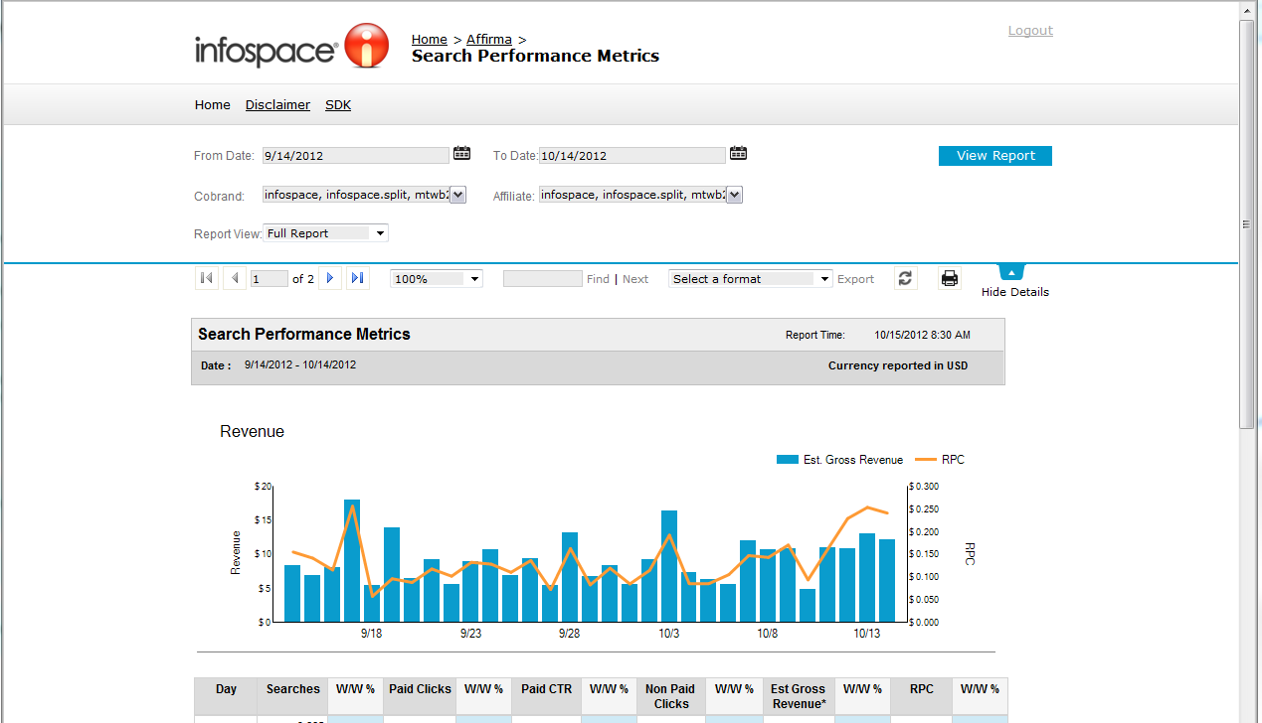
Blucora - Reporting Portal
Business Need
Blucora came to Affirma when they wanted to improve market share and regain competitive advantage. Blucora’s business model revolves around aggregating web data for clients and providing that data via SSRS 2008 reports. Limited by the bland SSRS default portal design, Blucora needed to update the visual appeal of these reports in order to tackle their emerging competition. Affirma was engaged to turn a standard SSRS portal into a visually stunning and interactive tool for clients.
What We Did
Affirma re-designed existing SSRS reports, while creating custom skins and functionality for the SSRS 2008 portal.
Historically, making customizations to any SSRS default portal had never been done before. Without any precedent for turning the standard SSRS portal into something visually appealing, Affirma’s team developed a creative and unique way to do so using JQuery, CSS and JavaScript.

Slide 48
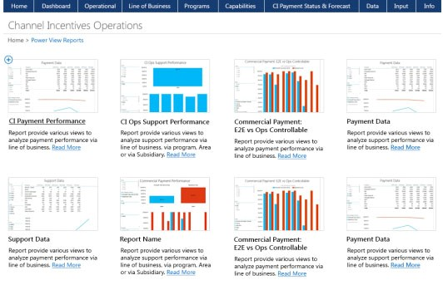
Microsoft CI Operations
Business Need
Microsoft Channel Incentives, the group responsible for managing payments to Microsoft Partner resellers had been missing the mark in a number of areas in terms of payments, satisfaction and performance. Initially the team had been manually entering all performance data into an application built for another department, and as a result weren’t getting the correct actionable information. What they needed was a custom-built business intelligence score carding solution, which would allow them multiple dashboard views to understand areas of opportunity. The business need was a cause analysis of problems such as why there weren’t paying incentives on time, why they weren’t accurate, which areas were having the most problems with and which programs were experiencing the most difficulty.
What We Did
Built a rock level entry form attached to a SQL database. This database then was attached to a number of custom-built dashboard views so the CI team could gain better insight into areas of opportunity.
Built out a number of flexible reporting tools in PowerView and SSRS so that users could export and manipulate data for granular analysis.

Slide 49
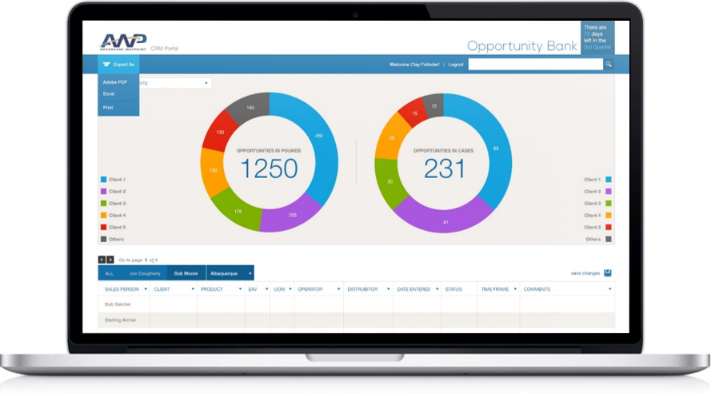
AWP CRM Dashboards
Business Need
One of the country’s leading food service brokerages Advantage Waypoint (AWP) was looking to gain a competitive advantage by empowering team members to quickly consume information about, and collaborate together on, business opportunities, thereby improving overall productivity and efficiency.
What We Did
Designed and developed an internal CRM tool which dynamically displayed information from disparate systems
Role based views designed to accommodate business needs
Relevant AWP users are able to change the status of opportunities to close, thereby realizing revenue faster and improving sales efficiency

Slide 50
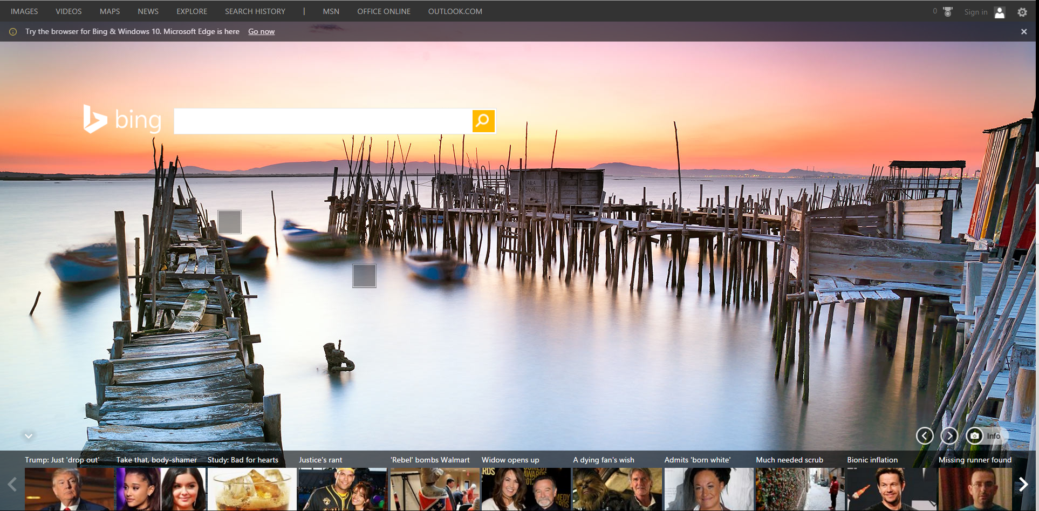
Bing BI Reporting
Business Need
Bing’s Feature Groups needed a centralized location to monitor performance data on individual features of their web experience.
What We Did
Affirma provided SSRS consulting and architecture services and deployed SQL Server Reporting Services as a central reporting delivery mechanism.
Implemented reports on top of cubes built on petabyte database. Customized Reporting Services to meet the custom needs of the team. Leveraged the model features to allow for easier ad hoc report building.
The custom reporting platform was delivered on time and under budget. The resulting scorecard was well received by the executive team and ultimately decreased response time by a factor of 10.

Slide 51

Seattle Parks & Recreation - BI
Business Need
City of Seattle Parks & Recreation came to Affirma for assistance in developing their BI strategy. They had extremely manual processes in place for aggregating data across multiple legacy reporting systems.
What We Did Affirma worked with key stakeholders to fully understand reporting needs. Our consulting team analyzed their current systems, defined long term reporting needs, and fully developed an enhanced BI strategy to support their long term goals.

Slide 52
Thank You

